Slide 1
Mental Health eScreening
OEF/OIF/OND Tablet Enrollment Training for MSAs
November 18, 2014

Slide 2
MSA introduction to the eScreening tablet system
For the last 2 years, members of CESAMH (Center for Excellence in Stress and Mental Health) have been monitoring appointment wait times for OOO veterans enrolling in Member Services, and the subsequent wait time to be seen in the Mental Health Access Clinic. We’ve also been tracking OOO Vets for depression, suicide risk, PTSD, and more.
We found that about 50% of the newly enrolled had risk factors for suicide. That’s half! A very large number of them had symptoms of depression or anxiety and the majority of these younger veterans were in physical pain. It’s critical that we improve appointment wait times, and with your help, we can.

Slide 3
We have compared wait times for Veterans using paper packet forms, versus times for Veterans using CESAMH tablets to self-assess during enrollment--and found that almost all of the tablet-using Vets who wanted help were able to speak with a clinician within 3 days, versus 2-3 months with the old paper packet forms.
This is a fantastic leap forward in patient care. We are asking you to work with us as we roll out a new, upgraded, tablet system with a faster and more user-friendly interface. We now have the cutting edge technology, but without you we can’t make the process work.

Slide 4
Yes, we are asking you to take on a greater responsibility. But, today I’m going to show you how that entire responsibility is only going to take about ten extra seconds… We’re not asking for minutes, just ten seconds.
And this one easy step is going to change the way that new veterans look at you. It will change the way they look at their healthcare. It will change the way they look at the entire VA System. And, it will save lives.
Let me show you how it works.

Slide 5
Today’s training covers:
Overview 5 minutes
Setting Up a Battery of Screens 4 minutes
User Roles & Permissions 2 minutes
Dashboard Features 3 minutes
Troubleshooting & Support 1 minute
1
2
3
4
5

Slide 6
1 | Overview
What is Mental Health eScreening (MHE)?
It’s an electronic assessment system that automates the manual, paper-based process used for initial screening of Veterans in VA healthcare settings.
MHE enables Veterans to complete self-assessments on a tablet or PC while in a clinic.
MHE accelerates patient enrollment by allowing clinicians to oversee the patient-directed screening with real-time scoring, chart note generation, and if pre-determined parameters are exceeded, immediate crisis alerts.
Goals
Facilitate comprehensive mental health screening for newly enrolling Veterans nationwide.
Increase the number of Veterans receiving mental health services.
Improve patient engagement and satisfaction, without an increase in staff and resources.
Gather health data and share with clinicians to improve care delivery to Veterans.

Slide 7
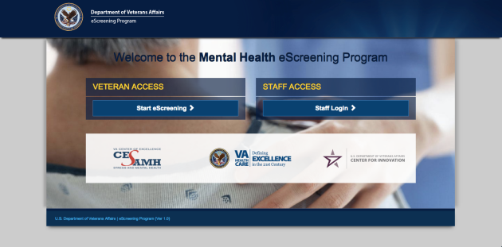
1 | Accessing the application
Access the MHE application with a tablet or a PC, by typing the web address into your browser’s URL field: http://vaww.escreening.va.gov/sd/
The address will be added to the Shared Drive.
The Welcome screen opens:

Slide 8
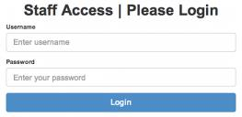

1 | Logging in
Click Staff Login >. The Staff Access | Please Login screen opens:
Type your user name and password, then click Login.
The Home screen opens:

Slide 9

1 | Logging out
Click Logout.
The system logs you out.
Automatic logout
If you are inactive for 20 minutes, the system will warn that you have 20 seconds before an automatic logout. You must interact with the program if you want to keep your session open. If the system logs you out but you want to keep working, simply log in again.

Slide 10
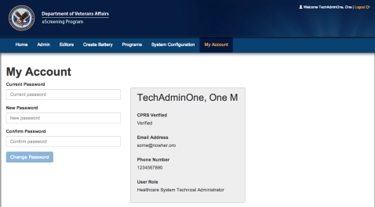
1 | Changing your password
From your Home page, click My Account. The My Account tab opens:
Type your current password.
Type and re-type your new password, then click Change Password. The system updates your password.

Slide 11
1
Overview 5 minutes
2
User Roles & Permissions 2 minutes
3
Setting Up a Battery of Screens 4 minutes
4
Dashboard Features 3 minutes
5
Troubleshooting & Additional Support 1 minute
11

Slide 12
2 | User roles and permissions
MHE System Roles
Consultation and Program Evaluation (done by CESAMH)
Healthcare System Administrator
Clinician
Medical Support Assistant
Veteran
Healthcare System Technical Administrator
Reporting and Metrics
Extracts clinical Battery data from the eScreening database for all sites, to:
identify trends and compare them for program and progress evaluation, and
provide feedback for improvement.
Clinical Editing
Creates, edits, deletes, & uploads Batteries.
Manages Battery errors.
Monitors the Battery dashboard with alerts.
Edits clinics and clinical reminders.
Completes forms and follow-ups.
Patient Care
Receives clinical data from CPRS.
Utilizes the health data collected through the eScreening application.
Medical Support
Creates Batteries for Veterans to complete in the waiting room.
The Patient
Completes the Screening Battery.
Technical Support
Edits and assigns users;
manages system level settings.

Slide 13
2 | User Management - Security
Tablets will not function outside of the hospital grounds.
Tablets have built-in tracking capability.
The system records the name and address of the last Veteran who used a missing tablet.
MSAs are not held responsible for tablets which are stolen or broken by a Veteran.

Slide 14
1
Overview 5 minutes
2
User Roles & Permissions 2 minutes
3
Setting Up a Battery of Screens 4 minutes
4
Dashboard Features 3 minutes
5
Troubleshooting & Support 1 minute
14

Slide 15
3 | Setting up a Battery of screens
Before a Veteran can begin eScreening, one of these users must set up a Battery of screens:
Healthcare System Clinical Administrator,
Clinician, or
Medical Support Assistant.
Setting up a Battery of screens consists of these procedures done in sequence:
Create a Veteran record (or locate one) in the database (DB).
Assign a new battery to the Veteran.
After A and B are complete, the system is ready to accept input on a tablet from the Veteran.

Slide 16

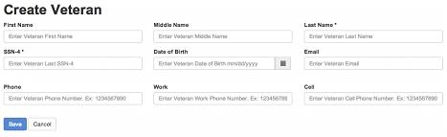
3 | Setting up a Battery of screens
A. Creating a Veteran Record in the DB
From the Home screen, click the Create Battery tab. The Select Veteran screen opens.
Click +Create Veteran Record in DB.
The Create Veteran screen opens.
Type the information, then click Save. Fields marked with an asterisk (*) are required. The Veteran Detail screen opens, showing a status that the Veteran exists in DB.

Slide 17
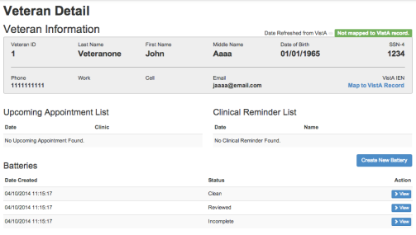
3 | Setting Up a Battery of Screens
B. Assigning a New Battery to a Veteran
Now that a record exists for the Veteran, you can assign a Battery for the Veteran to complete in the waiting room.
From the Veteran Detail screen, click Create New Battery.

Slide 18
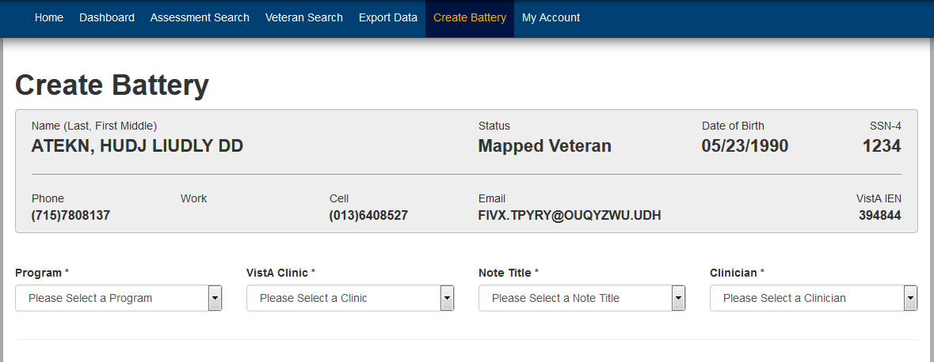
3 | Setting Up a Battery of Screens
B. Assigning a New Battery to a Veteran
The Create Battery screen opens.
Click the lists and select your Program, Clinic, Note Title, and Clinician.

Slide 19
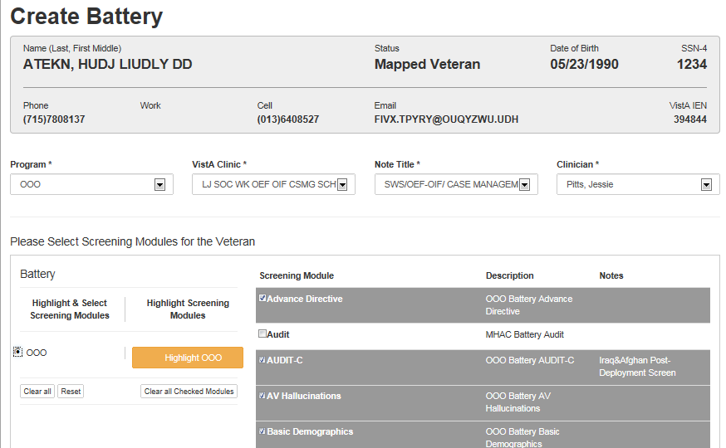
3 | Setting Up a Battery of Screens
B. Assigning a New Battery to a Veteran
Click the OOO option button, then scroll and view the pre-created batteries and modules available for the Veteran, then make any changes that you want.
Click Save. The system tells you that Battery creation was successful.

Slide 20
1
Overview 5 minutes
2
User Roles & Permissions 2 minutes
3
Setting Up a Battery of Screens 4 minutes
4
Dashboard Features 3 minutes
5
Troubleshooting & Support 1 minute
20

Slide 21
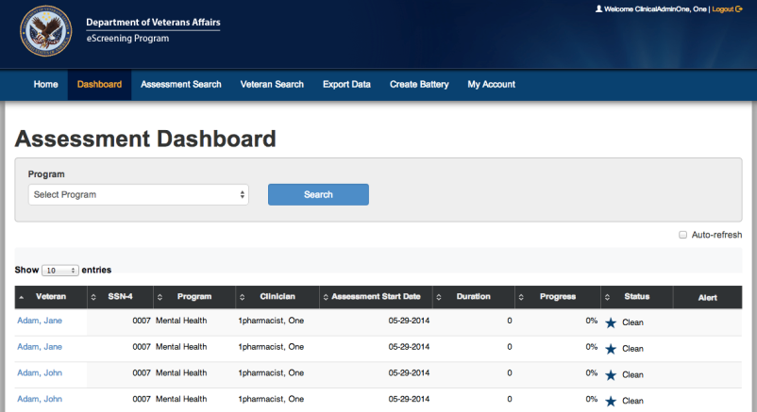
4 | Dashboard Features
From the Home screen, click Dashboard.
The Dashboard opens in List view.

Slide 22
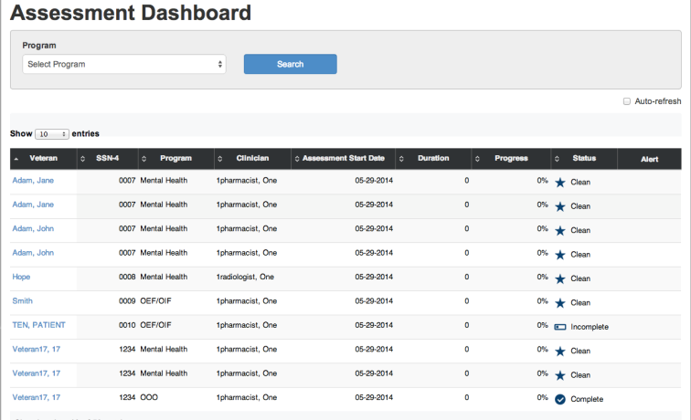
4 | Dashboard Features
The dashboard LIST View shows:
Which Veteran has a battery scheduled, in progress, or completed.
Any alerts associated with the screenings.

Slide 23
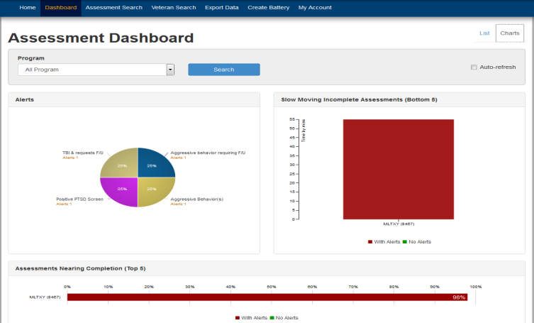
4 | Dashboard Features
The dashboard CHARTS View also shows:
Which Veteran has a battery scheduled, in progress, or completed.
Any alerts associated with the screenings.

Slide 24
1
Application Overview and Basics 5 minutes
2
Assigning a Battery of Screens 2 minutes
3
Taking the Battery 4 minutes
4
Dashboard Features 3 minutes
5
Troubleshooting & Support 1 minute
24

Slide 25
6| Troubleshooting & Support
Additional Training
Supplemental and future trainings options:
Review the audio recording of the User Training Manual
Future refresher training, as needed
Review the User Training Manual
Contact your training points of contact:
Liz Floto
858-552-8585 Ext. 5550
Elizabeth.floto@va.gov
Matthew Morgan 858-552-8585 ext.5557
Matthew.Morgan@va.gov

Slide 26
Practice Assessment creation in the system here:
https://vaww.escreening.va.gov/sd/
Click STAFF ACCESS.
Username: VHASDC******
Password: Password#1

Slide 27
Questions?

Slide 28
Thank you for attending the training!

